Slide 1
Smart Skill Mirror : AR-Based Machine Training Platform
K.Swathi Royal : 23RH1A66H4 K.Hari Keerthana : 23RH1A66F3 K.Akanksha : 23RH1A66D6

Slide 2
Introduction to Smart Skill Mirror
The Smart Skill Mirror is an innovative AR-based platform designed for machine training and skill development.
It utilizes augmented reality to provide real-time guidance and feedback to users.
This technology aims to enhance training efficiency and improve operational accuracy across various industries.

Slide 3
Core Features of the Platform
The platform integrates AR overlays to visualize complex machine operations step-by-step.
It tracks user movements and interactions to ensure correct technique and safety compliance.
The system offers customizable training modules tailored to specific machines and skill levels.

Slide 4

Technology Overview
Smart Skill Mirror combines augmented reality, computer vision, and AI to deliver immersive training experiences.
It employs advanced sensors to monitoruser
performance and detect errorsinstantly.
The platform runs on a user-friendly interface accessible via smart mirrors or AR headsets.

Slide 5

Benefits for Training Programs
It reduces training time immediate, interactive learners.
by providing
feedback to
The platform minimizes the need for physical training materials and on-site supervision.
It helps standardize training procedures, ensuring consistent skill acquisition across trainees.

Slide 6
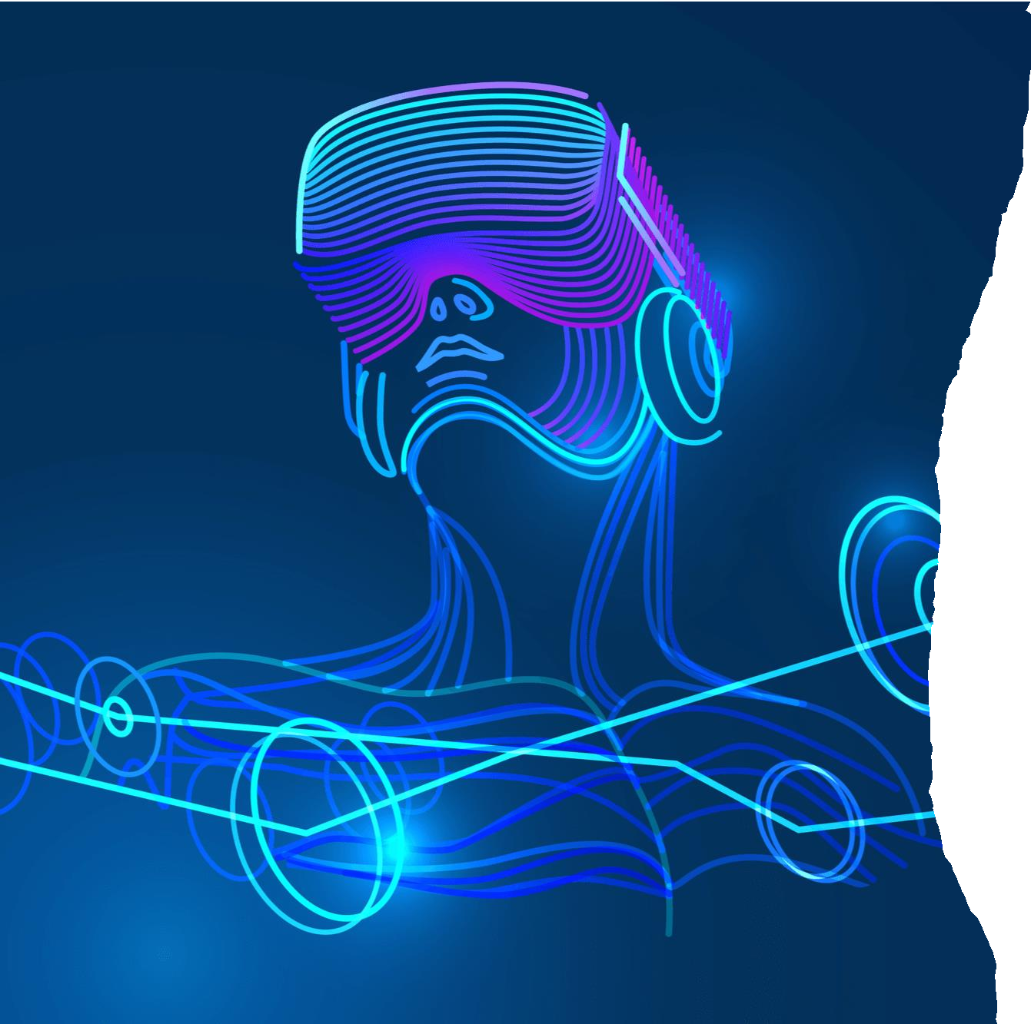
Industry Applications
The Smart Skill Mirror is ideal for manufacturing, automotive, and aerospace industries.
It can be used for training maintenance, assembly, and safety procedures.
The platform supports remote training, enabling experts to guide trainees worldwide.

Slide 7
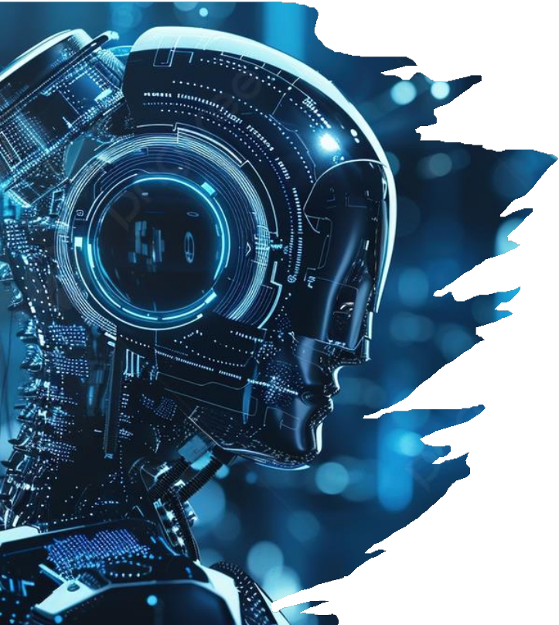
User Experience and Interaction
Users interact with virtual models and step- by-step instructions overlaid on real equipment.
The platform adapts to individual learning paces and provides personalized feedback.
It encourages active engagement, making
learning more effective and enjoyable.

Slide 8
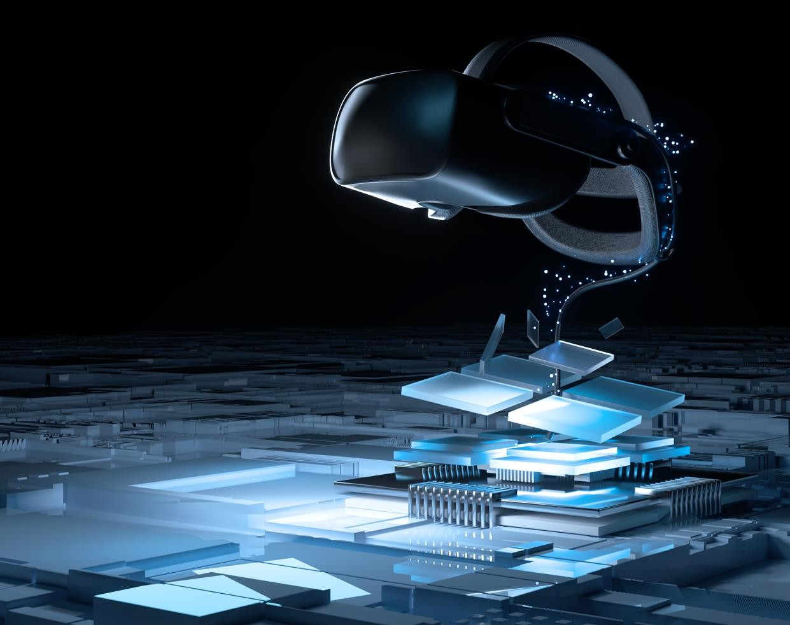

Implementation and Integration
Seamless integration with existing training curricula
and enterprise systems is a key feature.
The setup involves calibration with specific machines and user profiles.
Ongoing support and updates ensure the platform
remains current with technological advancements.

Slide 9
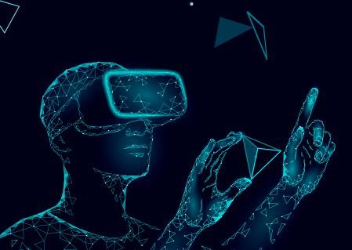

Challenges and Future Developments
Some challenges include hardware costs and ensuring compatibility across different environments.
Future developments aim to incorporate more AI-driven analytics and predictive maintenance features.
Continuous innovation will expand the platform's capabilities and application scope.

Slide 10
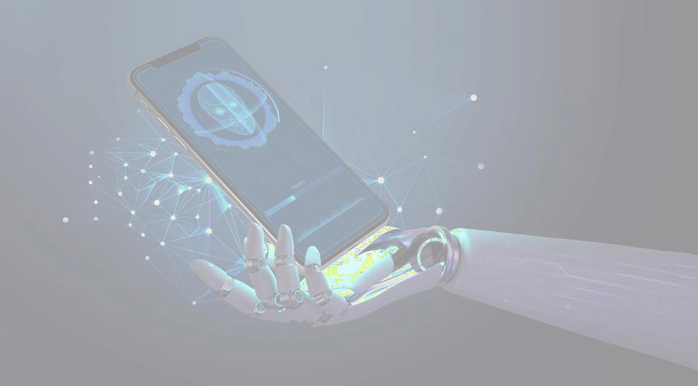
Conclusion and Outlook
The Smart Skill Mirror represents a significant step forward in AR-based industrial training.
It offers scalable, immersive, and efficient solutions for skill enhancement andsafety.
As technology advances, the platform will become an indispensable tool formodern workforce development.

Slide 11
